Slide 1
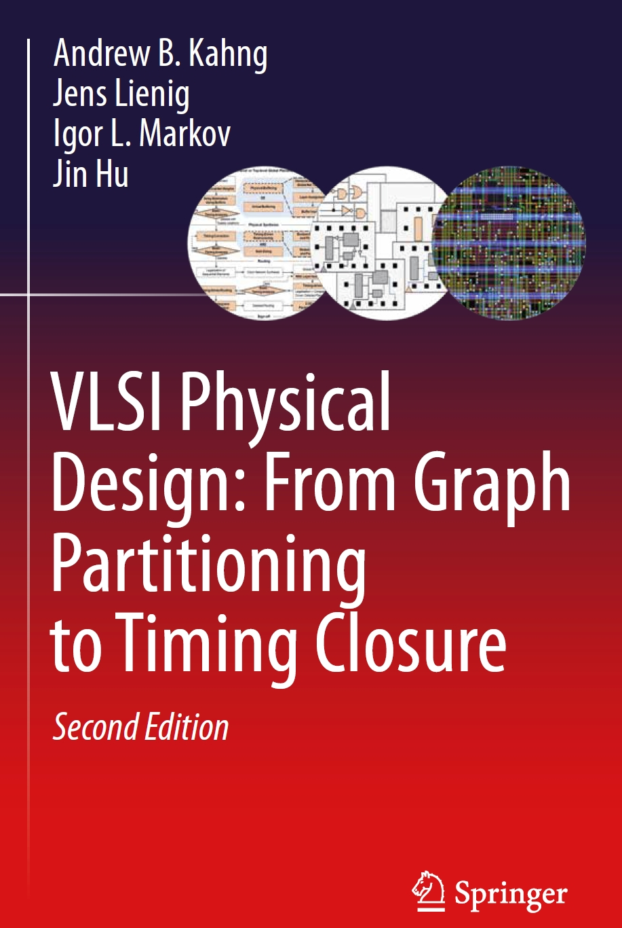
Chapter 3 – Chip Planning

Slide 2
Chapter 3 – Chip Planning
3.1 Introduction to Floorplanning
3.2 Optimization Goals in Floorplanning
3.3 Terminology
3.4 Floorplan Representations
3.4.1 Floorplan to a Constraint-Graph Pair
3.4.2 Floorplan to a Sequence Pair
3.4.3 Sequence Pair to a Floorplan
3.5 Floorplanning Algorithms
3.5.1 Floorplan Sizing
3.5.2 Cluster Growth
3.5.3 Simulated Annealing
3.5.4 Integrated Floorplanning Algorithms
3.6 Pin Assignment
3.7 Power and Ground Routing
3.7.1 Design of a Power-Ground Distribution Network
3.7.2 Planar Routing
3.7.3 Mesh Routing

Slide 3
3.1 Introduction
System Specification
Partitioning
Architectural Design
ENTITY test is port a: in bit; end ENTITY test;
Functional Design and Logic Design
Chip Planning
Circuit Design
Placement
Physical Design
Clock Tree Synthesis
Physical Verification and Signoff
DRC LVS
ERC
Signal Routing
Fabrication
Timing Closure
Packaging and Testing
Chip

Slide 4
3.1 Introduction
I/O Pads
Floorplan
Module a
Module b
Block a
Block c
Module c
Chip Planning
GND
Block d
VDD
Block Pins
Block b
Module d
Block e
Module e
Supply Network
© 2022 Springer Verlag

Slide 5
3.1 Introduction
Example
Given: Three blocks with the following potential widths and heights
Block A: w = 1, h = 4 or w = 4, h = 1 or w = 2, h = 2
Block B: w = 1, h = 2 or w = 2, h = 1
Block C: w = 1, h = 3 or w = 3, h = 1
Task: Floorplan with minimum total area enclosed
C
A
B
B
C
A
A

Slide 6
3.1 Introduction
Example
Given: Three blocks with the following potential widths and heights
Block A: w = 1, h = 4 or w = 4, h = 1 or w = 2, h = 2
Block B: w = 1, h = 2 or w = 2, h = 1
Block C: w = 1, h = 3 or w = 3, h = 1
Task: Floorplan with minimum total area enclosed

Slide 7
3.1 Introduction
Example
Given: Three blocks with the following potential widths and heights
Block A: w = 1, h = 4 or w = 4, h = 1 or w = 2, h = 2
Block B: w = 1, h = 2 or w = 2, h = 1
Block C: w = 1, h = 3 or w = 3, h = 1
Task: Floorplan with minimum total area enclosed
Solution:
Aspect ratios Block A with w = 2, h = 2; Block B with w = 2, h = 1; Block C with w = 1, h = 3
This floorplan has a global bounding box with minimum possible area (9 square units).

Slide 8
3.2 Optimization Goals in Floorplanning
Area and shape of the global bounding box
Global bounding box of a floorplan is the minimum axis-aligned rectangle that contains all floorplan blocks.
Area of the global bounding box represents the area of the top-level floorplan
Minimizing the area involves finding (x,y) locations, as well as shapes, of the individual blocks.
Total wirelength
Long connections between blocks may increase signal propagation delays in the design.
Combination of area area(F) and total wirelength L(F) of floorplan F
Minimize  ∙ area(F) + (1 – ) ∙ L(F) where the parameter 0 ≤  ≤ 1 gives the relative importance between area(F) and L(F)
Signal delays
Static timing analysis is used to identify the interconnects that lie on critical paths.

Slide 9
3.3 Terminology
A rectangular dissection is a division of the chip area into a set of blocks or non-overlapping rectangles.
A slicing floorplan is a rectangular dissection
Obtained by repeatedly dividing each rectangle, starting with the entire chip area, into two smaller rectangles
Horizontal or vertical cut line.
A slicing tree or slicing floorplan tree is a binary tree with k leaves and k – 1 internal nodes
Each leaf represents a block
Each internal node represents a horizontal or vertical cut line.

Slide 10
3.3 Terminology
Slicing floorplan and two possible corresponding slicing trees
V
V
c
H
H
H
H
b
e
f
a
b
c
H
a
b
d
H
a
d
d
V
c
V
e
f
e
f

Slide 11
3.3 Terminology
Polish expression
V
c
H
H
b
f
a
A
B
∗
+
C
D
E
F
∗
+
e
b
c
H
+
a
d
d
V
e
f
Bottom up: V → ∗ and H → +
Length 2n-1 (n = Number of leaves of the slicing tree)

Slide 12
3.3 Terminology
Non-slicing floorplans (wheels)
b
b
c
a
e
e
a
c
d
d

Slide 13
3.3 Terminology
Floorplan tree: Tree that represents a hierarchical floorplan
d
H
b
e
g
V
H
c
a
f
H
W
h
i
H
h
i
a
b
c
d
e
f
g
H
Horizontal division (objects to the top and bottom)
H
W
Wheel (4 objects cycled around a center object)
Vertical division (objects to the left and right)
H
© 2022 Springer Verlag
V
H

Slide 14
3.3 Terminology
In a vertical constraint graph (VCG), node weights represent the heights of the corresponding blocks.
Two nodes v_{i} and v_{j}, with corresponding blocks m_{i} and m_{j}, are connected with a directed edge from v_{i} to v_{j} if m_{i} is below m_{j}.
In a horizontal constraint graph (HCG), node weights represent the widths of the corresponding blocks.
Two nodes v_{i} and v_{j}, with corresponding blocks m_{i} and m_{j}, are connected with a directed edge from v_{i} to v_{j} if m_{i} is to the left of m_{j}.
The longest path(s) in the VCG / HCG correspond(s) to the minimum vertical / horizontal floorplan span required to pack the blocks (floorplan height / width).
A constraint-graph pair is a floorplan representation that consists of two directed graphs – vertical constraint graph and horizontal constraint graph – which capture the relations between block positions.

Slide 15
3.3 Terminology
Constraint graphs
d
t
b
e
g
b
d
e
a
c
f
g
h
a
c
f
i
h
b
d
e
Vertical Constraint Graph
g
i
s
a
c
f
t
s
h
i
© 2022 Springer Verlag
Horizontal Constraint Graph

Slide 16
3.3 Terminology
Sequence pair
Two permutations represent geometric relations between every pair of blocks
Example: (ABDCE, CBAED)
Horizontal and vertical relations between blocks A and B:
(… A … B … , … A … B …) → A is left of B
(… A … B … , … B … A …) → A is above B
(… B … A … , … A … B …) → A is below B
(… B … A … , … B … A …) → A is right of B
A
D
B
C
E

Slide 17
3.4 Floorplan Representations
3.1 Introduction to Floorplanning
3.2 Optimization Goals in Floorplanning
3.3 Terminology
3.4 Floorplan Representations
3.4.1 Floorplan to a Constraint-Graph Pair
3.4.2 Floorplan to a Sequence Pair
3.4.3 Sequence Pair to a Floorplan
3.5 Floorplanning Algorithms
3.5.1 Floorplan Sizing
3.5.2 Cluster Growth
3.5.3 Simulated Annealing
3.5.4 Integrated Floorplanning Algorithms
3.6 Pin Assignment
3.7 Power and Ground Routing
3.7.1 Design of a Power-Ground Distribution Network
3.7.2 Planar Routing
3.7.3 Mesh Routing
17

Slide 18
3.4.1 Floorplan to a Constraint-Graph Pair
Create nodes for every block
In addition, create a source node and a sink one
a
b
a
b
s
t
c
d
e
c
d
e
18

Slide 19
3.4.1 Floorplan to a Constraint-Graph Pair
Create nodes for every block.
In addition, create a source node and a sink one.
Add a directed edge (A,B) if Block A is below/left of Block B. (HCG)
a
b
a
b
s
t
c
d
e
c
d
e
19

Slide 20
3.4.1 Floorplan to a Constraint-Graph Pair
Create nodes for every block.
In addition, create a source node and a sink one.
Add a directed edge (A,B) if Block A is below/left of Block B. (HCG)
Remove the redundant edges that can be derived from other edges by transitivity.
a
b
a
b
s
t
c
d
e
c
d
e
20

Slide 21
3.4.2 Floorplan to a Sequence Pair
Given two blocks A and B with
Locations: A = (x_{A},y_{A}) and B = (x_{B},y_{B})
Dimensions: A = (w_{A},h_{A}) and B = (w_{B},h_{B})
If and or , then A is left of B
If and or , then A is below B
a
b
c
d
e
21

Slide 22
3.4.3 Sequence Pair to a Floorplan
Start with the bottom left corner
Define a weighted sequence as a sequence of blocks based on width
Each block B has its own width w(B)
Old (traditional) algorithm: find the longest path through edges (O(n²))
Newer approach: find the longest common subsequence (LCS)
Given two weighted sequences S₁ and S₂, the LCS(S₁,S₂) is the longest sequence found in both S₁ and S₂
The length of LCS(S₁,S₂) is the sum of weights
For block placement:
LCS(S₊,S₋) returns the x-coordinates of all blocks
LCS(S₊^{R},S₋) returns the y-coordinates of all blocks (S₊^{R} is the reverse of S₊)
The length of LCS(S₊,S₋) and LCS(S₊^{R},S₋) is the width and height, respectively
22

Slide 23
3.4.3 Sequence Pair to a Floorplan
Algorithm: Longest Common Subsequence (LCS)
Input: sequences S₁ and S₂, weights of n blocks weights
Output: positions of each block positions, total span L
for (i = 1 to n) // initialization
block_order[S₂[i]] = i
lengths[i] = 0
for (i = 1 to n)
block = S₁[i] // current block
index = block_order[block]
positions[block] = lengths[index] // compute block position
t_span = positions[block] + weights[block] // finds length of sequence // from beginning to block
for (j = index to n) // update total length
if (t_span > lengths[j]) lengths[j] = t_span
else break
L = lengths[n] // total length is stored here
23

Slide 24
3.4.3 Sequence Pair to a Floorplan
Example: S₁ = <acdbe>, S₂ = <cdaeb>, widths[a b c d e] = [8 4 4 4 4], heights[a b c d e] = [4 2 5 5 6]
Find x-coordinates – go by S₁’s order:
Initial: block_order[a b c d e] = [3 5 1 2 4], lengths = [0 0 0 0 0]
Iteration 1 – block = a, index = 3: positions[a] = lengths[3] = 0, t_span = 8, lengths = [0 0 8 8 8]
Iteration 2 – block = c, index = 1: positions[c] = lengths[1] = 0, t_span = 4, lengths = [4 4 8 8 8]
Iteration 3 – block = d, index = 2: positions[d] = lengths[2] = 4, t_span = 8, lengths = [4 8 8 8 8]
Iteration 4 – block = b, index = 5: positions[b] = lengths[5] = 8, t_span = 12, lengths = [4 8 8 8 12]
Iteration 5 – block = e, index = 4: positions[e] = lengths[4] = 8, t_span = 12, lengths = [4 8 8 12 12]
positions[a b c d e] = [0 8 0 4 8], total_width = lengths[n = 5] = 12
24

Slide 25
3.4.3 Sequence Pair to a Floorplan
Example: S₁ = <acdbe>, S₂ = <cdaeb>, widths[a b c d e] = [8 4 4 4 4], heights[a b c d e] = [4 3 5 5 6]
Find y-coordinates – go by S₁^{R}’s order:
Initial: block_order[a b c d e] = [3 5 1 2 4], lengths = [0 0 0 0 0]
Iteration 1 – block = e, index = 4: positions[e] = lengths[4] = 0, t_span = 6, lengths = [0 0 0 6 6]
Iteration 2 – block = b, index = 5: positions[b] = lengths[5] = 6, t_span = 9, lengths = [0 0 0 6 9]
Iteration 3 – block = d, index = 2: positions[d] = lengths[2] = 0, t_span = 5, lengths = [0 5 5 6 9]
Iteration 4 – block = c, index = 1: positions[c] = lengths[1] = 0, t_span = 5, lengths = [5 5 5 6 9]
Iteration 5 – block = a, index = 3: positions[a] = lengths[3] = 5, t_span = 9, lengths = [5 5 9 9 9]
positions[a b c d e] = [5 6 0 0 0], total_height = lengths[n = 5] = 9
25

Slide 26
3.5 Floorplanning Algorithms
3.1 Introduction to Floorplanning
3.2 Optimization Goals in Floorplanning
3.3 Terminology
3.4 Floorplan Representations
3.4.1 Floorplan to a Constraint-Graph Pair
3.4.2 Floorplan to a Sequence Pair
3.4.3 Sequence Pair to a Floorplan
3.5 Floorplanning Algorithms
3.5.1 Floorplan Sizing
3.5.2 Cluster Growth
3.5.3 Simulated Annealing
3.5.4 Integrated Floorplanning Algorithms
3.6 Pin Assignment
3.7 Power and Ground Routing
3.7.1 Design of a Power-Ground Distribution Network
3.7.2 Planar Routing
3.7.3 Mesh Routing

Slide 27
3.5 Floorplanning Algorithms
Common Goals
To minimize the total length of interconnect, subject to an upper bound on the floorplan area
or
To simultaneously optimize both wire length and area
Otten, R.: Efficient Floorplan Optimization. Int. Conf. on Computer Design, 499-502, 1983
27

Slide 28
3.5.1 Floorplan Sizing
Shape functions
h
h
Legal shapes
Legal shapes
Otten, R.: Efficient Floorplan Optimization. Int. Conf. on Computer Design, 499-502, 1983
w
w
h_{a}*_{a}w ≥ A
Block with minimum width and height restrictions

Slide 29
3.5.1 Floorplan Sizing
Shape functions
h
h
Otten, R.: Efficient Floorplan Optimization. Int. Conf. on Computer Design, 499-502, 1983
w
w
Discrete (h,w) values
Hard library block

Slide 30
3.5.1 Floorplan Sizing
Corner points
h
5
5
2
2
2
5
w
2
5

Slide 31
3.5.1 Floorplan Sizing
Algorithm
This algorithm finds the minimum floorplan area for a given slicing floorplan in
polynomial time. For non-slicing floorplans, the problem is NP-hard.
Construct the shape functions of all individual blocks
Bottom up: Determine the shape function of the top-level floorplan from the shape functions of the individual blocks
Top down: From the corner point that corresponds to the minimum top-level floorplan area, trace back to each block’s shape function to find that block’s dimensions and location.

Slide 32
3.5.1 Floorplan Sizing – Example
Step 1: Construct the shape functions of the blocks
3
Block A:
5
5
3
Block B:
4
2
2
4

Slide 33
3.5.1 Floorplan Sizing – Example
Step 1: Construct the shape functions of the blocks
3
h
Block A:
5
5
3
6
5
Block B:
4
4
2
2
2
4
2
3
4
6
w

Slide 34
3.5.1 Floorplan Sizing – Example
Step 1: Construct the shape functions of the blocks
3
h
Block A:
5
5
3
6
Block B:
4
3
4
2
2
2
4
2
4
5
6
w

Slide 35
3.5.1 Floorplan Sizing – Example
Step 1: Construct the shape functions of the blocks
3
h
Block A:
5
5
3
6
Block B:
4
h_{A}(w)
4
2
2
2
4
2
4
6
w

Slide 36
3.5.1 Floorplan Sizing – Example
Step 1: Construct the shape functions of the blocks
3
h
Block A:
5
5
3
6
Block B:
4
h_{A}(w)
4
2
h_{B}(w)
2
2
4
2
4
6
w

Slide 37
3.5.1 Floorplan Sizing – Example
Step 2: Determine the shape function of the top-level floorplan (vertical)
h
8
6
4
h_{A}(w)
2
h_{B}(w)
2
4
6
w

Slide 38
3.5.1 Floorplan Sizing – Example
Step 2: Determine the shape function of the top-level floorplan (vertical)
h
8
6
4
h_{A}(w)
2
h_{B}(w)
2
4
6
w

Slide 39
3.5.1 Floorplan Sizing – Example
Step 2: Determine the shape function of the top-level floorplan (vertical)
h
h
8
8
6
6
h_{C}(w)
4
4
h_{A}(w)
h_{A}(w)
2
h_{B}(w)
2
h_{B}(w)
2
4
6
w
2
4
6
w

Slide 40
3.5.1 Floorplan Sizing – Example
Step 2: Determine the shape function of the top-level floorplan (vertical)
h
h
8
8
6
6
h_{C}(w)
4
4
h_{A}(w)
h_{A}(w)
2
h_{B}(w)
2
5 x 5
h_{B}(w)
2
4
6
w
2
4
6
w

Slide 41
3.5.1 Floorplan Sizing – Example
Step 2: Determine the shape function of the top-level floorplan (vertical)
3 x 9
h
h
8
8
6
6
4 x 7
h_{C}(w)
4
4
h_{A}(w)
h_{A}(w)
2
h_{B}(w)
2
5 x 5
h_{B}(w)
2
4
6
w
2
4
6
w

Slide 42
3.5.1 Floorplan Sizing – Example
Step 2: Determine the shape function of the top-level floorplan (vertical)
3 x 9
h
h
8
8
6
6
4 x 7
h_{C}(w)
4
4
h_{A}(w)
h_{A}(w)
2
h_{B}(w)
2
5 x 5
h_{B}(w)
2
4
6
w
2
4
6
w
Minimimum top-level floorplan
with vertical composition

Slide 43
3.5.1 Floorplan Sizing – Example
Step 2: Determine the shape function of the top-level floorplan (horizontal)
h_{B}(w)
h_{A}(w)
h_{B}(w)
h_{A}(w)
h_{C}(w)
h
h
5 x 5
6
6
4
4
7 x 4
2
2
2
4
6
8
w
2
4
6
8
w
9 x 3
Minimimum top-level floorplan
with horizontal composition

Slide 44
3.5.1 Floorplan Sizing – Example
Step 3: Find the individual blocks’ dimensions and locations
h
(1) Minimum area floorplan: 5 x 5
6
4
2
2
4
6
8
w
Horizontal composition

Slide 45
3.5.1 Floorplan Sizing – Example
Step 3: Find the individual blocks’ dimensions and locations
h
(1) Minimum area floorplan: 5 x 5
6
4
2
(2) Derived block dimensions : 2 x 4 and 3 x 5
2
4
6
8
w
Horizontal composition

Slide 46
3.5.1 Floorplan Sizing – Example
Step 3: Find the individual blocks’ dimensions and locations
h
(1) Minimum area floorplan: 5 x 5
6
5 x 5
4
2
(2) Derived block dimensions : 2 x 4 and 3 x 5
2
4
6
8
w
2 x 4
3 x 5
Horizontal composition

Slide 47
3.5.1 Floorplan Sizing – Example
5 x 5
V
Resulting slicing tree
B
A
B
A
2 x 4
3 x 5

Slide 48
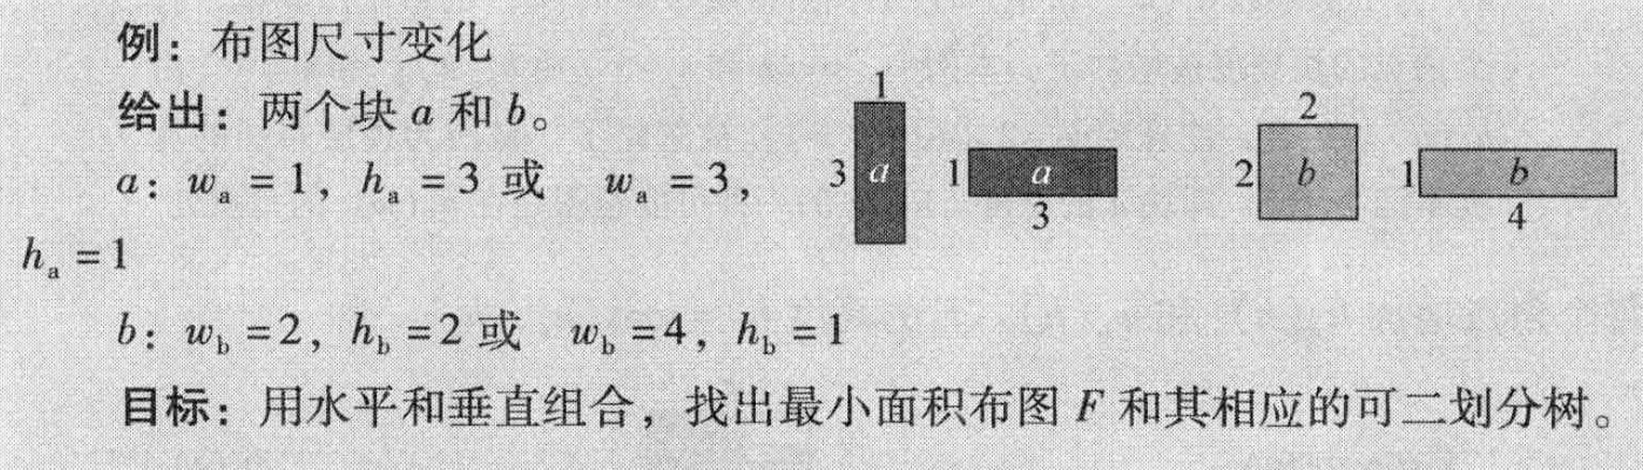
3.5.1 Floorplan Sizing – Example

Slide 49
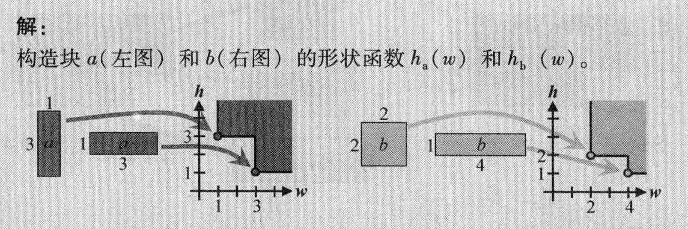
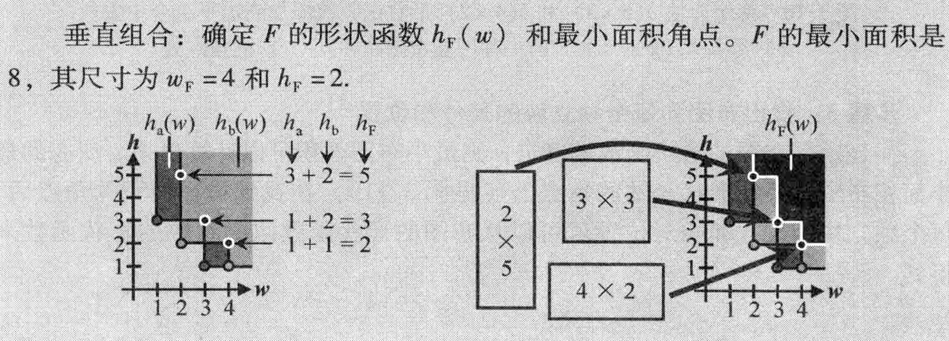
3.5.1 Floorplan Sizing – Example

Slide 50
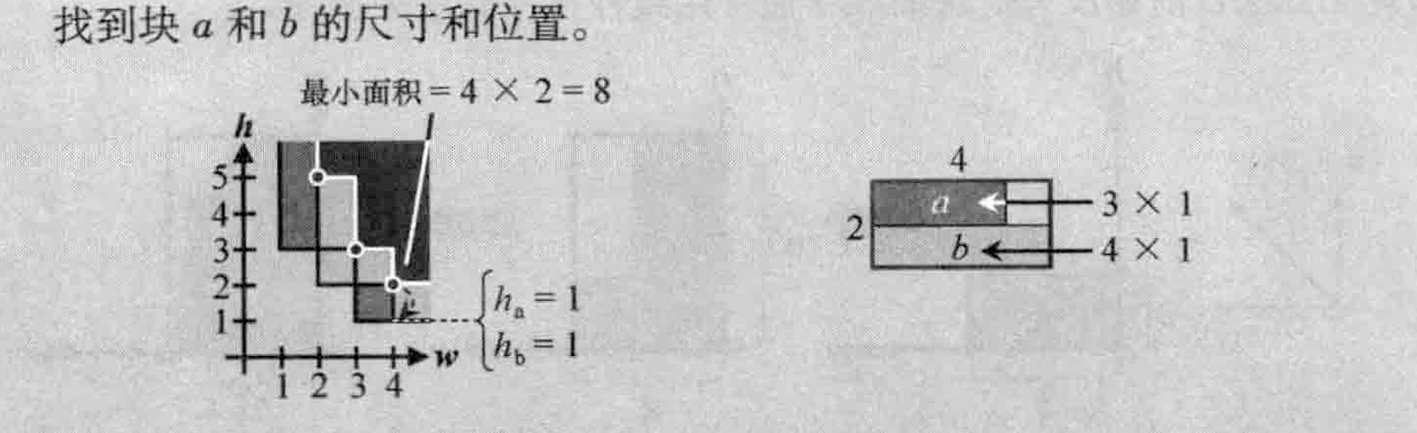
3.5.1 Floorplan Sizing – Example

Slide 51
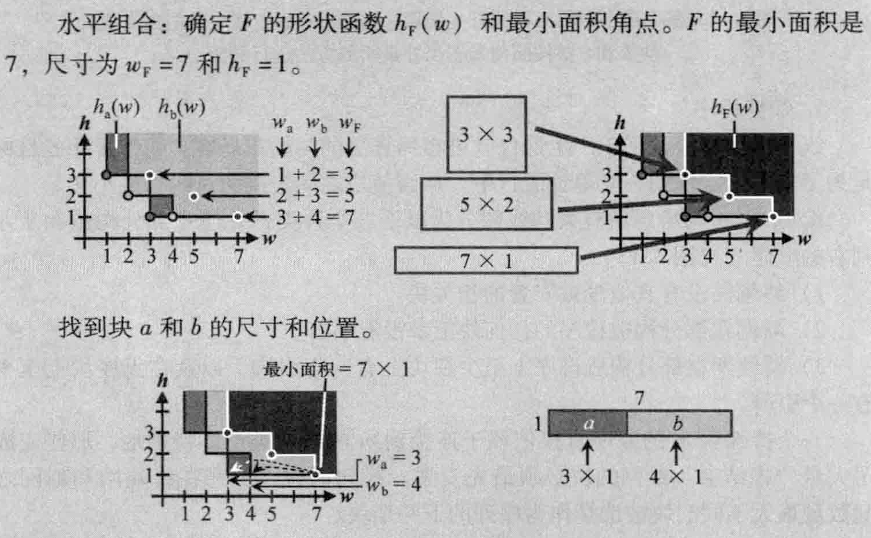
3.5.1 Floorplan Sizing – Example

Slide 52

3.5.1 Floorplan Sizing – Example

Slide 53
3.5.2 Cluster Growth
Iteratively add blocks to the cluster until all blocks are assigned
Only the different orientations of the blocks instead of the shape / aspect ratio are taken into account
Linear ordering to minimize total wirelength of connections between blocks
h
h
h
Growth direction
b
b
6
6
c
2
a
a
a
w
w
w
4
4
4
© 2022 Springer Verlag

Slide 54
3.5.2 Cluster Growth – Linear Ordering
New nets have no pins on any block from the partially-constructed ordering
Terminating nets have no other incident blocks that are unplaced
Continuing nets have at least one pin on a block from the partially-constructed ordering and at least one pin on an unordered block
Terminating nets
New nets
…
Continuing nets

Slide 55
3.5.2 Cluster Growth – Linear Ordering
Gain of each block m is calculated: Gain_{m} = (Number of terminating nets of m) – (New nets of m)
The block with the maximum gain is selected to be placed next
N₁
Gain_{B} = 1 – 1 = 0
A
B
N₄

Slide 56
3.5.2 Cluster Growth – Linear Ordering (Example)
N₃
N₁
N₅
A
B
C
D
E
N₂
N₆
N₄

Slide 57
N₃
N₁
N₅
A
B
C
D
E
N₂
N₆
N₄
Iteration #
Block
New Nets
Terminating Nets
Gain
Continuing Nets
0
A
N₁,N₂,N₃
--
-3
--
1
B
C
D
E
N₄
N₅
N₄,N₅,N₆
N₅,N₆
N₁
--
N₂
--
0
-1
-2
-2
--
N₃
--
N₃
Initial block
Gain_{A} = (Number of terminating nets of A) – (New nets of A)
2
C
D
E
N₅
N₅,N₆
N₅,N₆
--
N₂,N₄
--
-1
0
-2
N₃
--
N₃
3
C
E
--
--
--
N₆
0
1
N₃,N₅
N₃,N₅
N₃
4
N₁
N₄
N₅
C
--
N₃,N₅
2
--
A
B
D
E
C
N₂
N₆

Slide 58
N₃
N₁
N₅
A
B
C
D
E
N₂
N₆
N₄
Iteration #
Block
New Nets
Terminating Nets
Gain
Continuing Nets
0
A
N₁,N₂,N₃
--
-3
--
1
B
C
D
E
N₄
N₅
N₄,N₅,N₆
N₅,N₆
N₁
--
N₂
--
0
-1
-2
-2
--
N₃
--
N₃
2
C
D
E
N₅
N₅,N₆
N₅,N₆
--
N₂,N₄
--
-1
0
-2
N₃
--
N₃
3
C
E
--
--
--
N₆
0
1
N₃,N₅
N₃,N₅
N₃
4
N₁
N₄
N₅
C
--
N₃,N₅
2
--
A
B
D
E
C
N₂
N₆

Slide 59
N₃
N₁
N₅
A
B
C
D
E
N₂
N₆
N₄
Iteration #
Block
New Nets
Terminating Nets
Gain
Continuing Nets
0
A
N₁,N₂,N₃
--
-3
--
1
B
C
D
E
N₄
N₅
N₄,N₅,N₆
N₅,N₆
N₁
--
N₂
--
0
-1
-2
-2
--
N₃
--
N₃
2
C
D
E
N₅
N₅,N₆
N₅,N₆
--
N₂,N₄
--
-1
0
-2
N₃
--
N₃
3
C
E
--
--
--
N₆
0
1
N₃,N₅
N₃,N₅
N₃
4
N₁
N₄
N₅
C
--
N₃,N₅
2
--
A
B
D
E
C
N₂
N₆

Slide 60
N₃
N₁
N₅
A
B
C
D
E
N₂
N₆
N₄
Iteration #
Block
New Nets
Terminating Nets
Gain
Continuing Nets
0
A
N₁,N₂,N₃
--
-3
--
1
B
C
D
E
N₄
N₅
N₄,N₅,N₆
N₅,N₆
N₁
--
N₂
--
0
-1
-2
-2
--
N₃
--
N₃
2
C
D
E
N₅
N₅,N₆
N₅,N₆
--
N₂,N₄
--
-1
0
-2
N₃
--
N₃
3
C
E
--
--
--
N₆
0
1
N₃,N₅
N₃,N₅
4
C
--
N₃,N₅
2
--
© 2022 Springer Verlag

Slide 61
3.5.2 Cluster Growth – Linear Ordering (Example)
N₃
N₁
N₅
A
B
C
D
E
N₂
N₆
N₄
N₃
N₁
N₄
N₅
A
B
D
E
C
N₂
N₆

Slide 62
3.5.2 Cluster Growth – Algorithm
Input: set of all blocks M, cost function C
Output: optimized floorplan F based on C
F = Ø
order = LINEAR_ORDERING(M) // generate linear ordering
for (i = 1 to |order|)
curr_block = order[i]
ADD_TO_FLOORPLAN(F,curr_block,C) // find location and orientation // of curr_block that causes // smallest increase based on
// C while obeying constraints

Slide 63
3.5.2 Cluster Growth
The objective is to minimize the total wirelength of connections blocks
Though this produces mediocre solutions, the algorithm is easy to implement and fast.
Can be used to find the initial floorplan solutions for iterative algorithms such as simulated annealing.
Analysis
63

Slide 64
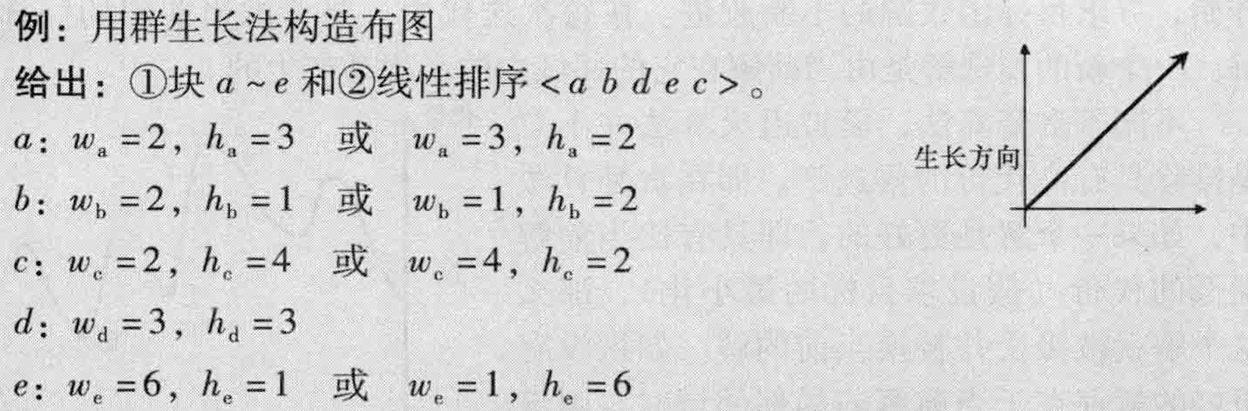
3.5.2 Cluster Growth
64

Slide 65
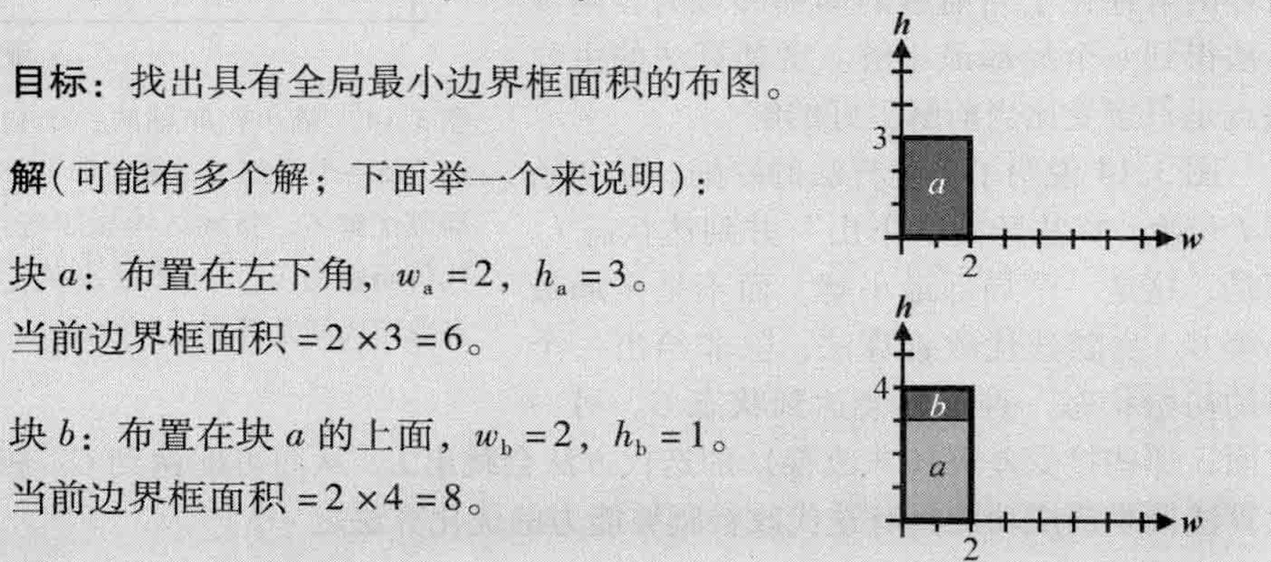
3.5.2 Cluster Growth
65

Slide 66
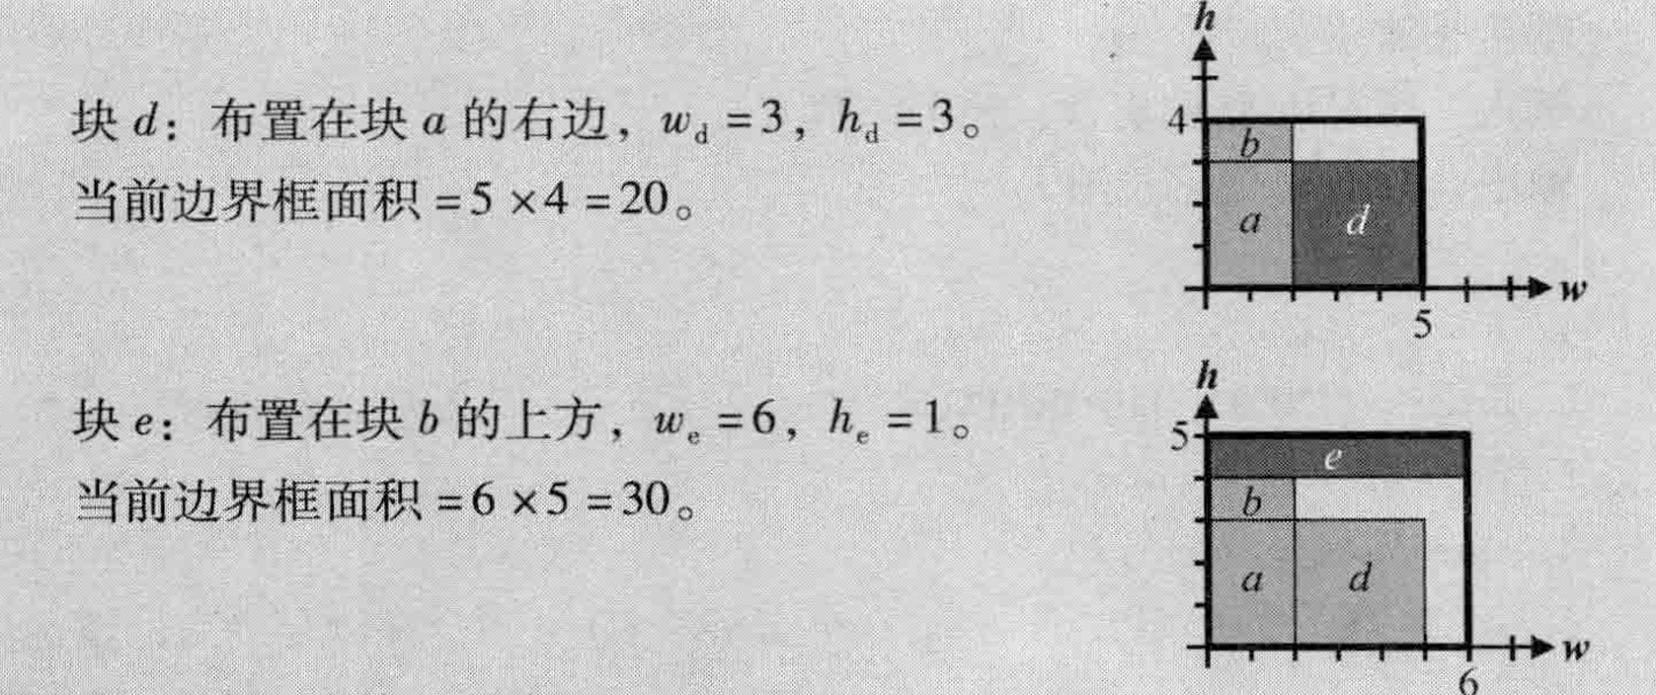
3.5.2 Cluster Growth
66

Slide 67
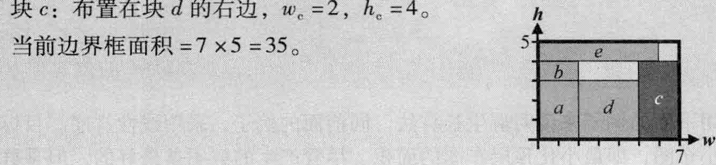
3.5.2 Cluster Growth
67

Slide 68
3.5.3 Simulated Annealing
Simulated Annealing (SA) algorithms are iterative in nature.
Begins with an initial (arbitrary) solution and seeks to incrementally improve the objective function.
During each iteration, a local neighborhood of the current solution is considered. A new candidate solution is formed by a small perturbation of the current solution.
Unlike greedy algorithms, SA algorithms can accept candidate solutions with higher cost.
Introduction
68

Slide 69
3.5.3 Simulated Annealing
Cost
Initial solution
Local optimum
Global optimum
Solution states

Slide 70
3.5.3 Simulated Annealing
Definition (from material science): controlled cooling process of high-temperature materials to modify their properties.
Cooling changes material structure from being highly randomized (chaotic) to being structured (stable).
The way that atoms settle in low-temperature state is probabilistic in nature.
Slower cooling has a higher probability of achieving a perfect lattice with minimum-energy
Cooling process occurs in steps
Atoms need enough time to try different structures
Sometimes, atoms may move across larger distances and create (intermediate) higher-energy states
Probability of the accepting higher-energy states decreases with temperature
What is annealing?
70

Slide 71
3.5.3 Simulated Annealing
Generate an initial solution S_{init}, and evaluate its cost.
Generate a new solution S_{new} by performing a random walk
S_{new} is accepted or rejected based on the temperature T
Higher T means a higher probability to accept S_{new} if COST(S_{new}) > COST(S_{init})
T slowly decreases to form the final solution
Boltzmann acceptance criterion, where r is a random number [0,1)
Simulated Annealing
71

Slide 72
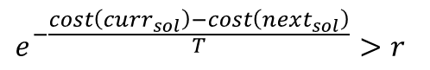
3.5.3 Simulated Annealing
Simulated Annealing
Generate an initial solution and evaluate its cost
Generate a new solution by performing a random walk
Solution is accepted or rejected based on a temperature parameter T
Higher T indicates higher probability to accept a solution with higher cost
T slowly decreases to form the finalized solution.
Boltzmann acceptance criterion:
curr_{sol} : current solution
next_{sol}: new solution after perturbation
T: current temperature
r: random number between[0,1) from normal distr.
72

Slide 73
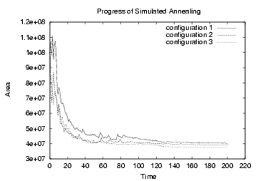
3.5.3 Simulated Annealing – Algorithm

Slide 74
3.5.3 Simulated Annealing – Algorithm
Input: initial solution init_sol
Output: optimized new solution curr_sol
T = T₀ // initialization
i = 0
curr_sol = init_sol
curr_cost = COST(curr_sol)
while (T > T_{min})
while (stopping criterion is not met)
i = i + 1
(a_{i},b_{i}) = SELECT_PAIR(curr_sol) // select two objects to perturb
trial_sol = TRY_MOVE(a_{i},b_{i}) // try small local change
trial_cost = COST(trial_sol)
Δcost = trial_cost – curr_cost
if (Δcost < 0) // if there is improvement,
curr_cost = trial_cost // update the cost and
curr_sol = MOVE(a_{i},b_{i}) // execute the move
else
r = RANDOM(0,1) // random number [0,1]
if (r < e ^{–Δcost/T}) // if it meets threshold,
curr_cost = trial_cost // update the cost and
curr_sol = MOVE(a_{i},b_{i}) // execute the move
T = α ∙ T // 0 < α < 1, T reduction
© 2022 Springer Verlag

Slide 75
3.6 Pin Assignment
3.1 Introduction to Floorplanning
3.2 Optimization Goals in Floorplanning
3.3 Terminology
3.4 Floorplan Representations
3.4.1 Floorplan to a Constraint-Graph Pair
3.4.2 Floorplan to a Sequence Pair
3.4.3 Sequence Pair to a Floorplan
3.5 Floorplanning Algorithms
3.5.1 Floorplan Sizing
3.5.2 Cluster Growth
3.5.3 Simulated Annealing
3.5.4 Integrated Floorplanning Algorithms
3.6 Pin Assignment
3.7 Power and Ground Routing
3.7.1 Design of a Power-Ground Distribution Network
3.7.2 Planar Routing
3.7.3 Mesh Routing

Slide 76
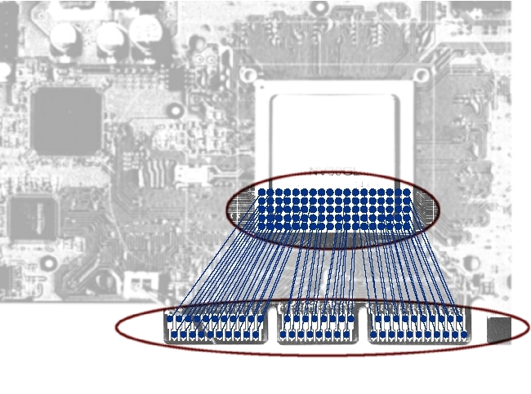
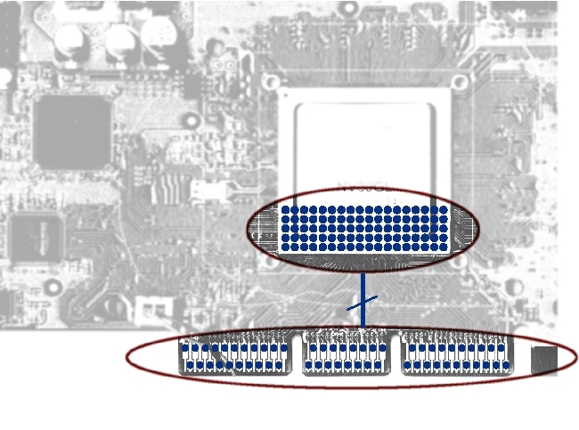
3.6 Pin Assignment
During pin assignment, all nets (signals) are assigned to unique pin locations such that the overall design performance is optimized.
Pin Assignment
90 Pins
90 Pins
90 Connections
90 Pins
90 Pins
© 2022 Springer Verlag

Slide 77
3.6 Pin Assignment – Example
Given: Two sets of pins
(1) Determine the circles
Koren, N. L.: Pin Assignment in Automated Printed Circuit Boards

Slide 78
3.6 Pin Assignment – Example
(2) Determine the points
Koren, N. L.: Pin Assignment in Automated Printed Circuit Boards

Slide 79
3.6 Pin Assignment – Example
(2) Determine the points
Koren, N. L.: Pin Assignment in Automated Printed Circuit Boards

Slide 80
3.6 Pin Assignment – Example
(3) Determine initial mapping
Koren, N. L.: Pin Assignment in Automated Printed Circuit Boards

Slide 81
3.6 Pin Assignment – Example
(3) Determine initial mapping and (4) optimize the mapping (complete rotation)
Koren, N. L.: Pin Assignment in Automated Printed Circuit Boards

Slide 82
3.6 Pin Assignment – Example
(3) Determine initial mapping and (4) optimize the mapping (complete rotation)
Koren, N. L.: Pin Assignment in Automated Printed Circuit Boards

Slide 83
3.6 Pin Assignment – Example
(4) Best mapping (shortest Euclidean distance)
Koren, N. L.: Pin Assignment in Automated Printed Circuit Boards

Slide 84
3.6 Pin Assignment – Example
(4) Best mapping
Final pin assignment
Koren, N. L.: Pin Assignment in Automated Printed Circuit Boards

Slide 85
3.6 Pin Assignment
Pin assignment to an external block B
B
B
B
H. N. Brady, “An Approach to Topological Pin Assignment”, IEEE Trans. on CAD 3(3) (1984), pp. 250-255
m
m
m
m
l’

Slide 86
3.6 Pin Assignment
Pin assignment to two external blocks A and B
a₇
a₆
a₈
a₅
a₈
a
b₇
b₆
d₂~d₁
a₇
a₁
a₄
a₆
b₈
b₅
a₅
a₂
a₃
b
b₁
b₄
a₄
b₂
b₃
b₈
b₇
H. N. Brady, “An Approach to Topological Pin Assignment”, IEEE Trans. on CAD 3(3) (1984), pp. 250-255
b₆
d₃~d₃
l_{m~a}
b₅
b₄
b₃
d₁
a
b₂
b₁
l_{m~b}
a₃
m
d₂
d₃
b
d₁~d₂
a₂
m
a₁

Slide 87
3.7 Power and Ground Routing
3.1 Introduction to Floorplanning
3.2 Optimization Goals in Floorplanning
3.3 Terminology
3.4 Floorplan Representations
3.4.1 Floorplan to a Constraint-Graph Pair
3.4.2 Floorplan to a Sequence Pair
3.4.3 Sequence Pair to a Floorplan
3.5 Floorplanning Algorithms
3.5.1 Floorplan Sizing
3.5.2 Cluster Growth
3.5.3 Simulated Annealing
3.5.4 Integrated Floorplanning Algorithms
3.6 Pin Assignment
3.7 Power and Ground Routing
3.7.1 Design of a Power-Ground Distribution Network
3.7.2 Planar Routing
3.7.3 Mesh Routing

Slide 88
3.7 Power and Ground Routing
Power-ground distribution for a chip floorplan
G
V
G
V
Power and ground rings per block or abutted blocks
V
V
G
G
V
G
V
V
G
G
V
G
V
G
V
Trunks connect rings to each other or to top-level power ring
© 2022 Springer Verlag

Slide 89
3.7 Power and Ground Routing
Planar routing
GND
VDD
Hamiltonian path
© 2022 Springer Verlag

Slide 90
3.7 Power and Ground Routing
Planar routing
Step 1: Planarize the topology of the nets
As both power and ground nets must be routed on one layer, the design should be split using the Hamiltonian path
Step 2: Layer assignment
Net segments are assigned to appropriate routing layers
Step 3: Determining the widths of the net segments
A segment’s width is determined from the sum of the currents from all the cells to which it connects

Slide 91
3.7 Power and Ground Routing
Planar routing
GND
VDD
Generating topology of the two supply nets
Adjusting widths of the segments with regard to their current loads

Slide 92
3.7 Power and Ground Routing
Mesh routing
Step 1: Creating a ring
A ring is constructed to surround the entire core area of the chip, and possibly individual blocks.
Step 2: Connecting I/O pads to the ring
Step 3: Creating a mesh
A power mesh consists of a set of stripes at defined pitches on two or more layers
Step 4: Creating Metal1 rails
Power mesh consists of a set of stripes at defined pitches on two or more layers
Step 5: Connecting the Metal1 rails to the mesh

Slide 93
3.7 Power and Ground Routing
Mesh routing
Power rail
Connector
Ring
Pad
Mesh
© 2022 Springer Verlag

Slide 94
3.7 Power and Ground Routing
Mesh routing
1μ Metal4 mesh
2μ Metal6 mesh
4μ Metal8 mesh
1μ Metal5 mesh
16μ
4μ Metal7 mesh
16μ
16μ
Metal1 rail
VDD Metal4 mesh
GND Metal4 mesh
Metal4
Via3
Metal6
Metal8
Metal3
Via5
Via7
Via2
GND rail
Metal5
Metal7
Metal2
Via4
Via6
© 2022 Springer Verlag
Via1
Metal4
Metal6
Metal1
VDD rail
M1-to-M4 connection
M4-to-M6 connection
M6-to-M8 connection

Slide 95
Summary of Chapter 3 – Objectives and Terminology
Traditional floorplanning
Assumes area estimates for top-level circuit modules
Determines shapes and locations of circuit modules
Minimizes chip area and length of global interconnect
Additional aspects
Assigning/placing I/O pads
Defining channels between blocks for routing and buffering
Design of power and ground networks
Estimation and optimization of chip timing and routing congestion
Fixed-outline floorplanning
Chip size is fixed, focus on interconnect optimization
Can be applied to individual chip partitions (hierarchically)
Structure and types of floorplans
Slicing versus non-slicing, the wheels
Hierarchical
Packed
Zero-deadspace

Slide 96
Summary of Chapter 3 – Data Structures for Floorplanning
Slicing trees and Polish expressions
Evaluating a floorplan represented by a Polish expression
Horizontal and vertical constraint graphs
A data structure to capture (non-slicing) floorplans
Longest paths determine floorplan dimensions
Sequence pair
An array-based data structure that captures the information
contained in H+V constraint graphs
Makes constraint graphs unnecessary in practice
Floorplan sizing
Shape-function arithmetic
An algorithm for slicing floorplans

Slide 97
Summary of Chapter 3 – Algorithms for Floorplanning
Cluster growth
Simple, fast and intuitive
Not competitive in practice
Simulated annealing
Stochastic optimization with hill-climbing
Many details required for high-quality implementation (e.g., temperature schedule)
Difficult to debug, fairly slow
Competitive in practice
Pin assignment
Peripheral I/Os versus area-array I/Os
Given "ideal locations", project them onto perimeter and shift around, while preserving initial ordering
Power and ground routing
Planar routing in channels between blocks
Can form rings around blocks to increase current supplied and to improve reliability
Mesh routing

